Slide 1


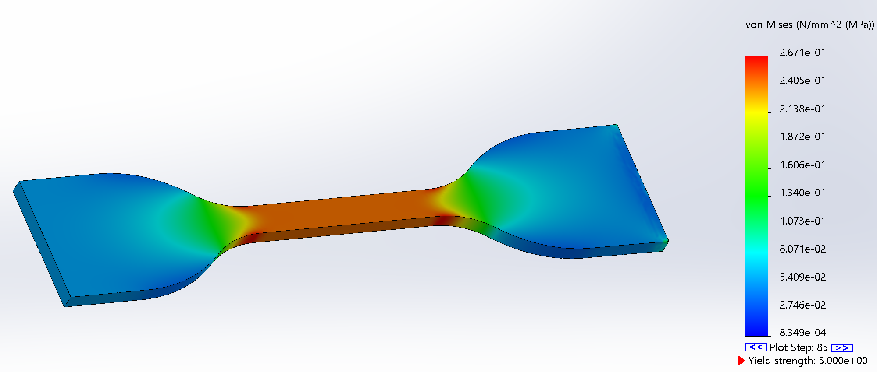
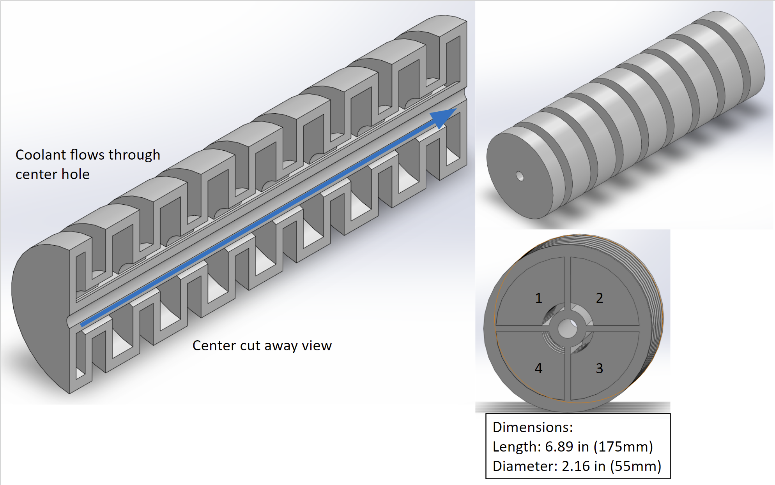
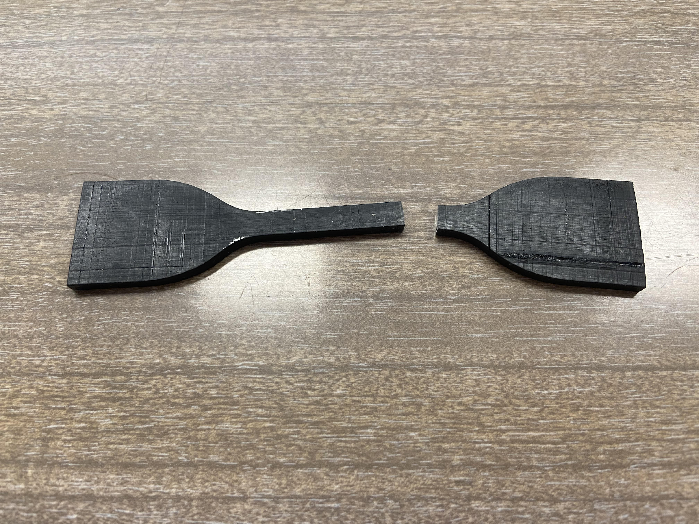
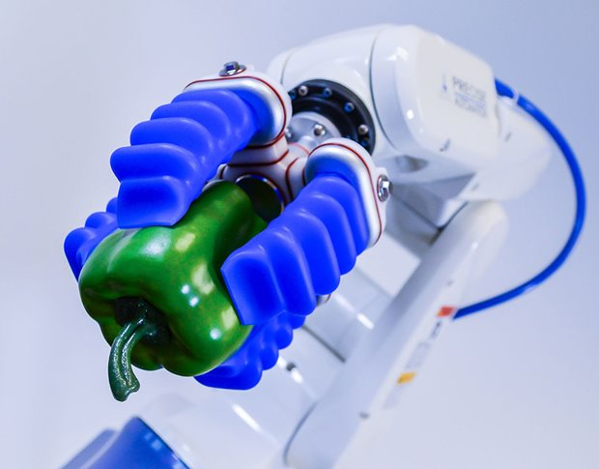
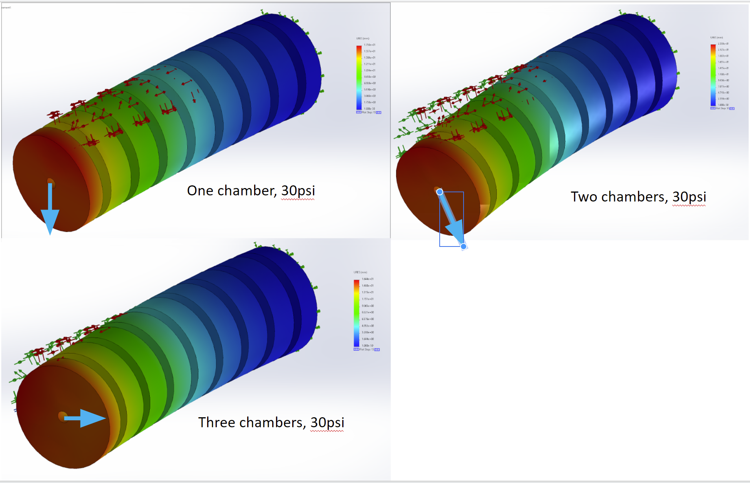
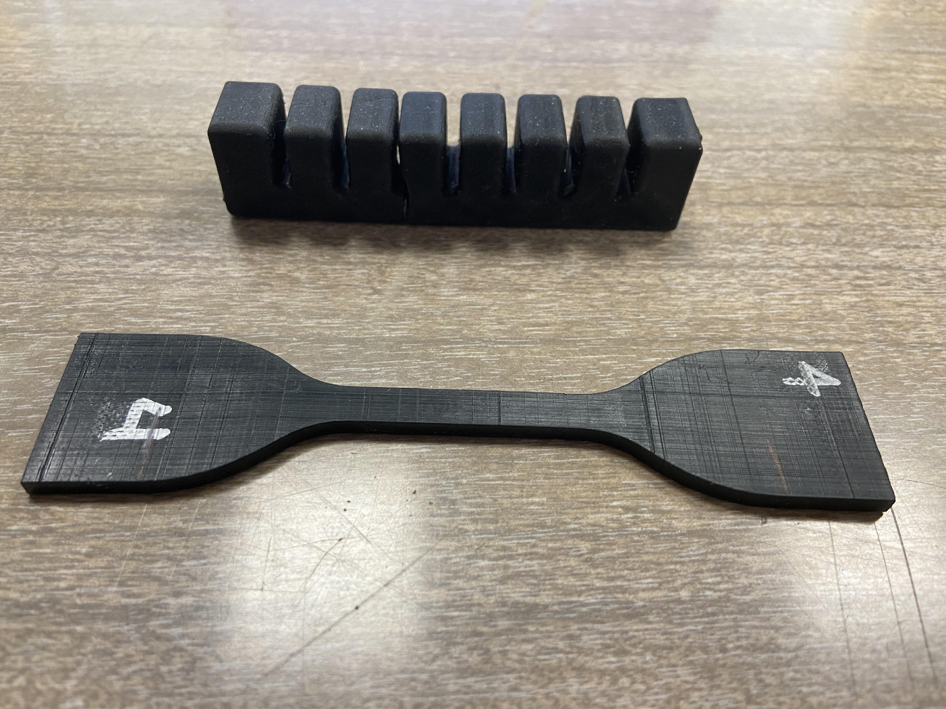
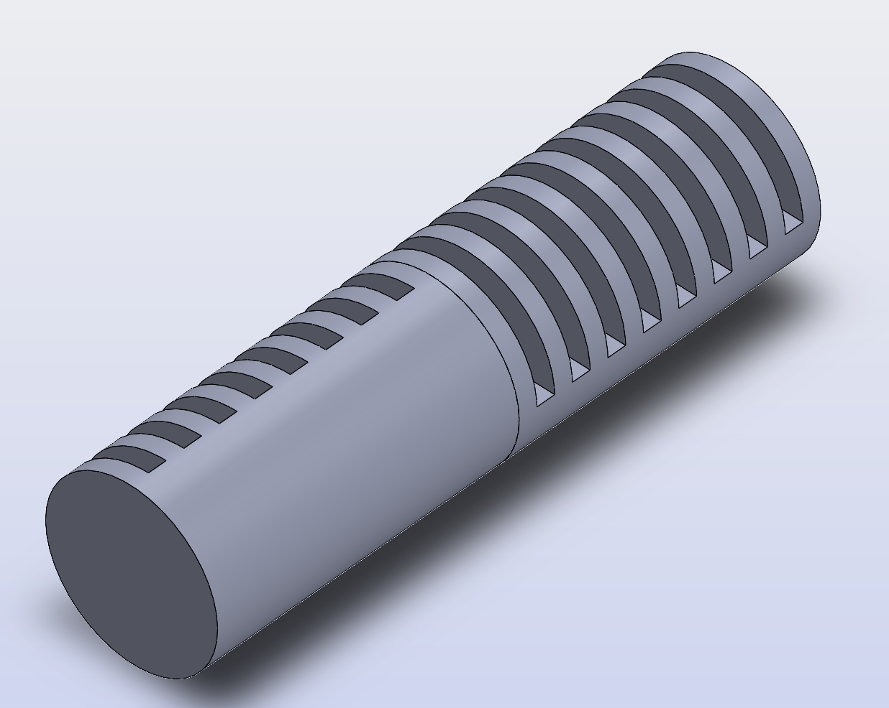
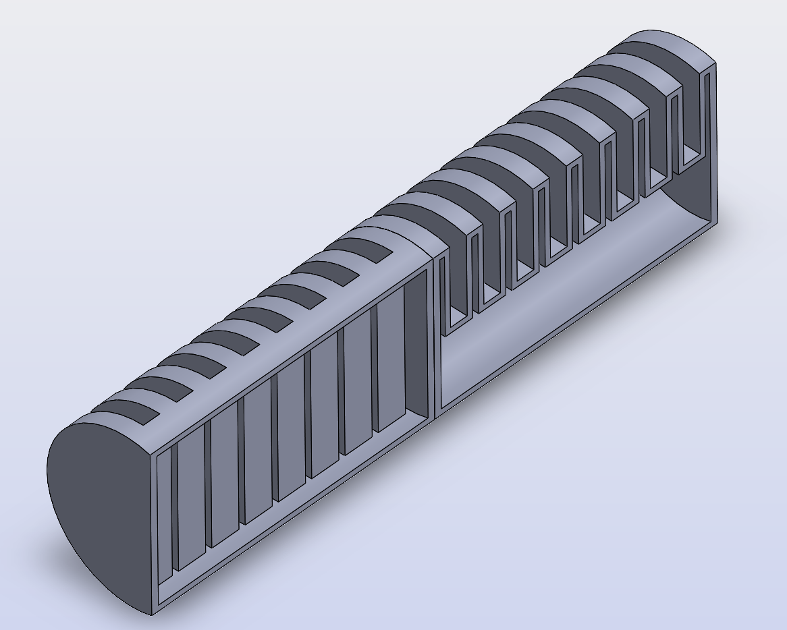
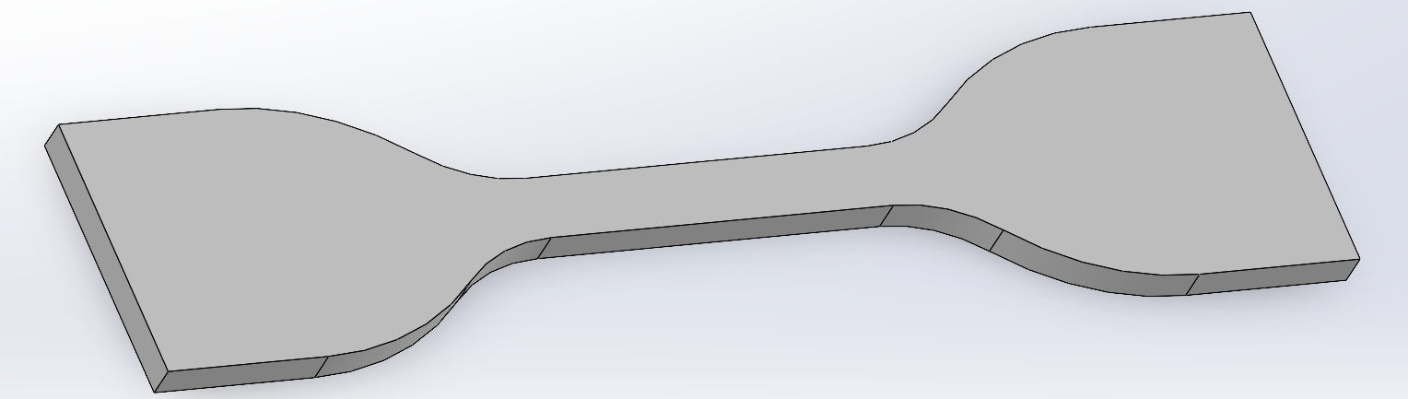
Establishing Soft Robot Modeling and Simulation Fundamentals to Drive Smart Nozzle Design
By: Kyle Naumann, Bailey Reid, and Patrick Hudak
Advisors: David Myszka, Ph.D & Andrew Murray, Ph.D
Department of Mechanical & Aerospace Engineering
Objective: Establish a correlation between Solidworks simulation data and tensile testing stress strain curves to reliably predict smart nozzle design actuation. Using UDRI’s digital light processing (DLP) printers, test materials and smart nozzle designs can be rapidly created to test and validate simulations and prototypes.
Modeling and Design
Soft Robotics Background
Area of robotics which utilizes flexible materials
Created out of polymers, urethanes, hydrogels and other manipulatable materials
Elastic properties of elastomers allow for rotational and translational actuation
Actuated thermally, pneumatically and electrically
Applications in industrial and biomedical settings
Simulation Validation
aasdfasd
First nozzle design concept
Tensile tests simulated using Solidworks FEA
Tensile testing carried out on DLP printed specimen using an Instron
Source: https://www.asme.org/topics-resources/content/seven-big-advances-in-soft-robotic-grippers
DLP Printing
Additive manufacturing technique
Polymerizes a layer of resin using light
Allows for rapid prototyping with elastic materials
Second nozzle design concept
Graph of all test data points with average linear fit applied
Replicate linear behavior using linear elastic models in Solidworks

